Slide 1
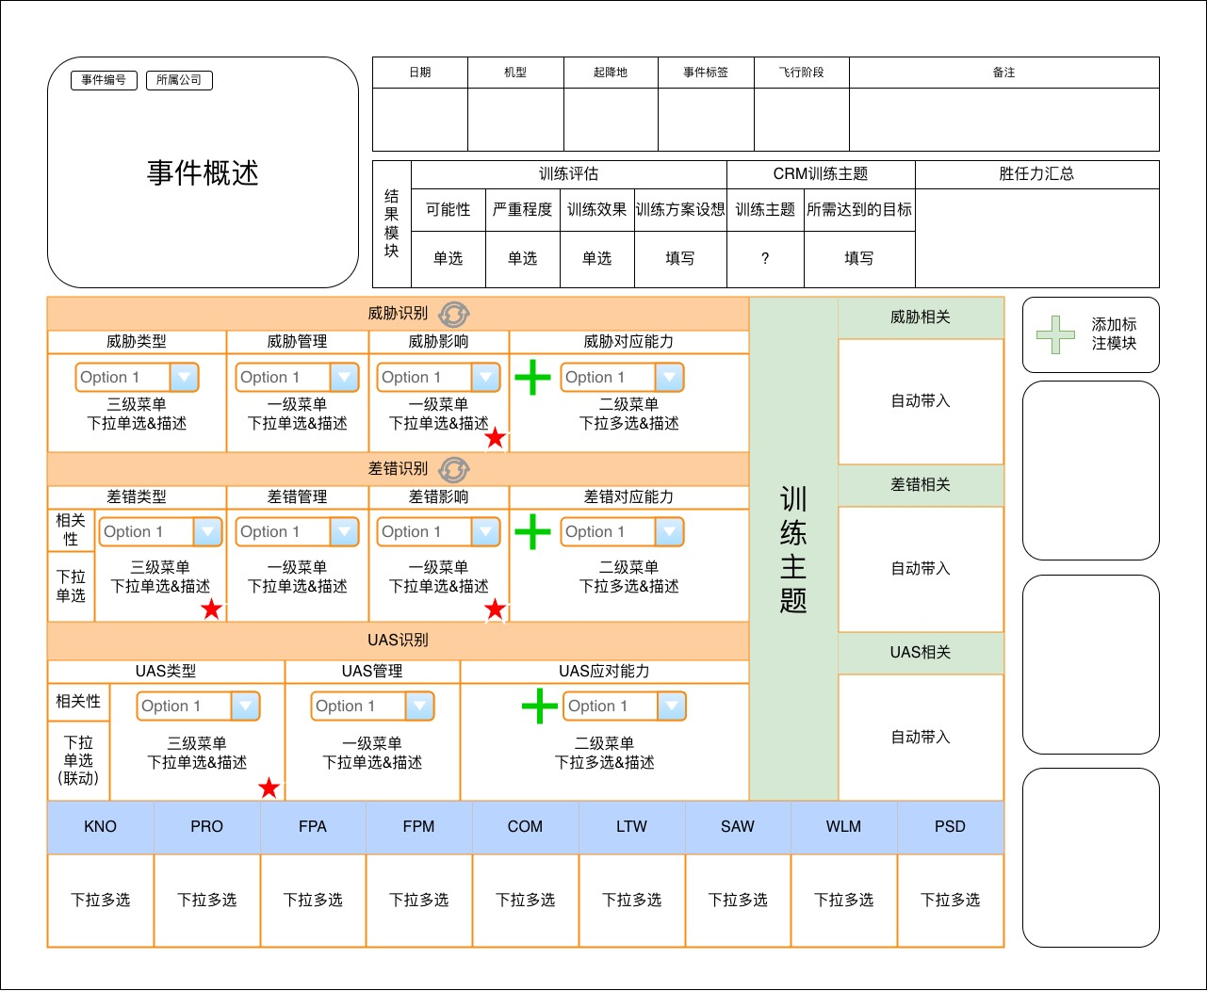
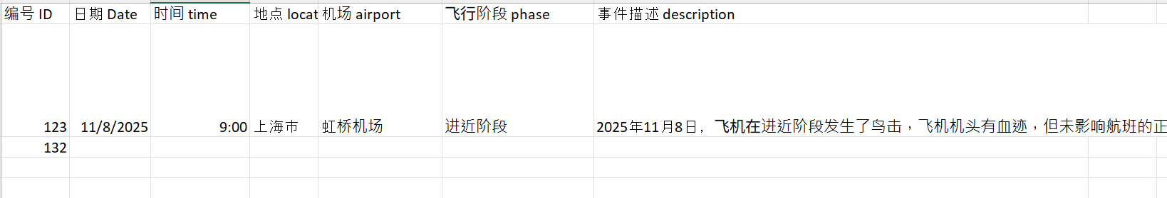
Read in from an excel file row
Ignore
User must manually fill
This is filled automatically based on user’s selection in the orange boxes. (there is a simple rule-base mapping)
User must click and select from a drop down menu or a pop up page/ pop up canvas.
Ignore

